Slide 1
Data Structure and Algorithm (PMSCS 623P)
Lecture 16
Graph-Based Algorithms

Slide 2
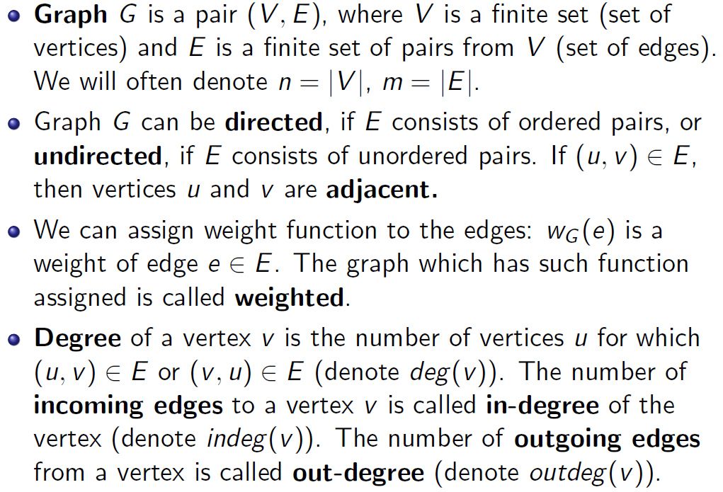
What is a Graph?

Slide 3
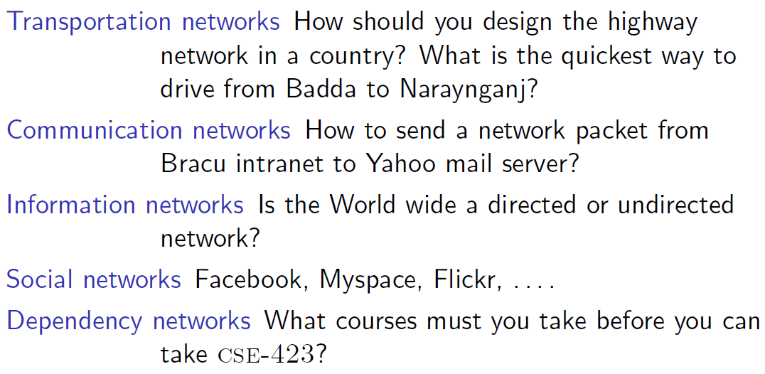
Examples of graphs

Slide 4
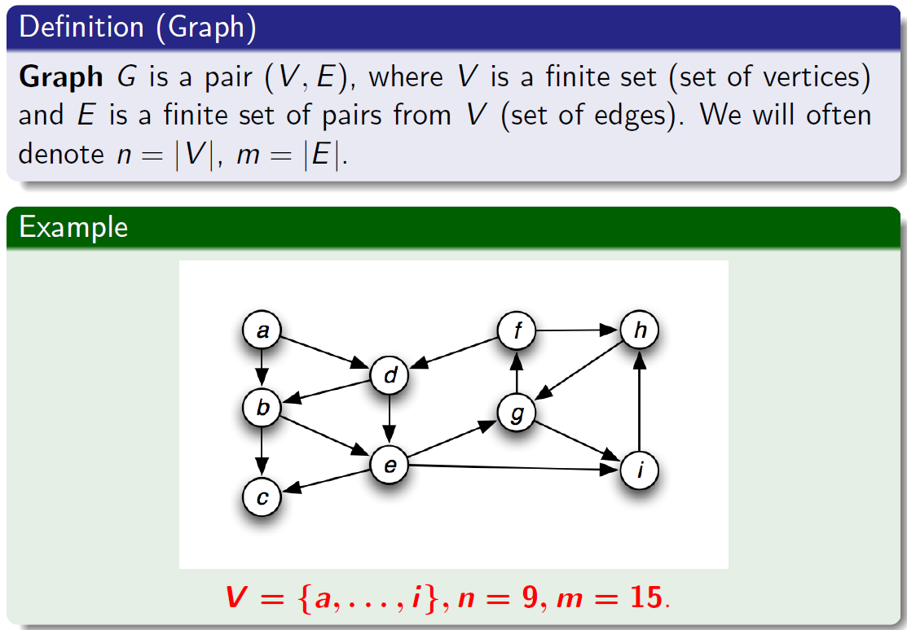
What is a Graph?

Slide 5
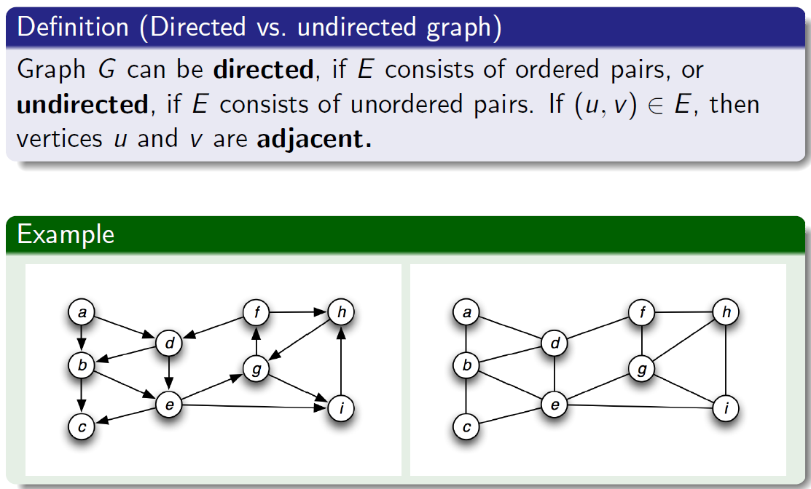
Directed vs. undirected graphs

Slide 6
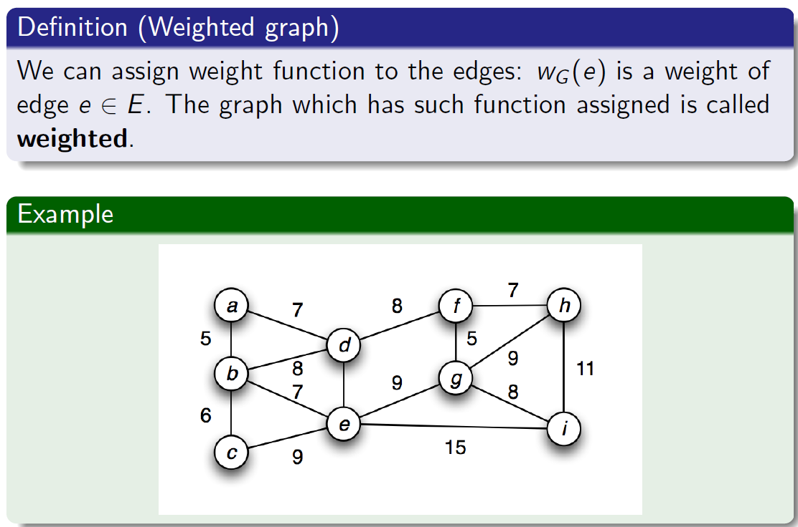
Weighted graphs

Slide 7
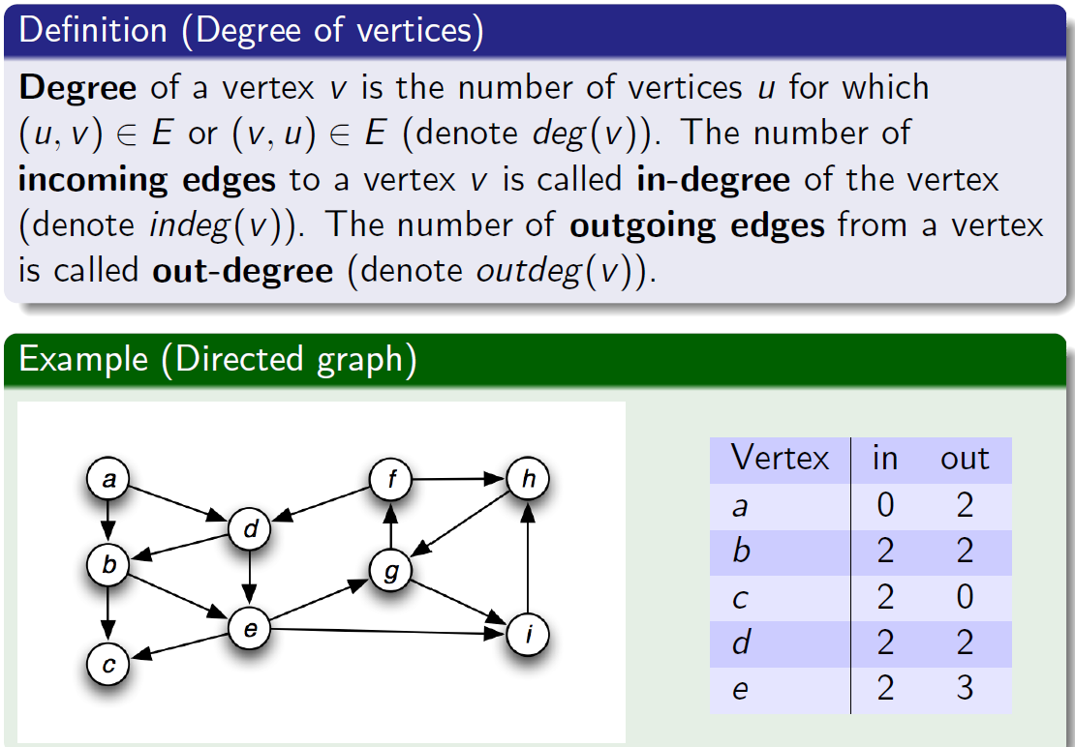
Degree of vertices

Slide 8
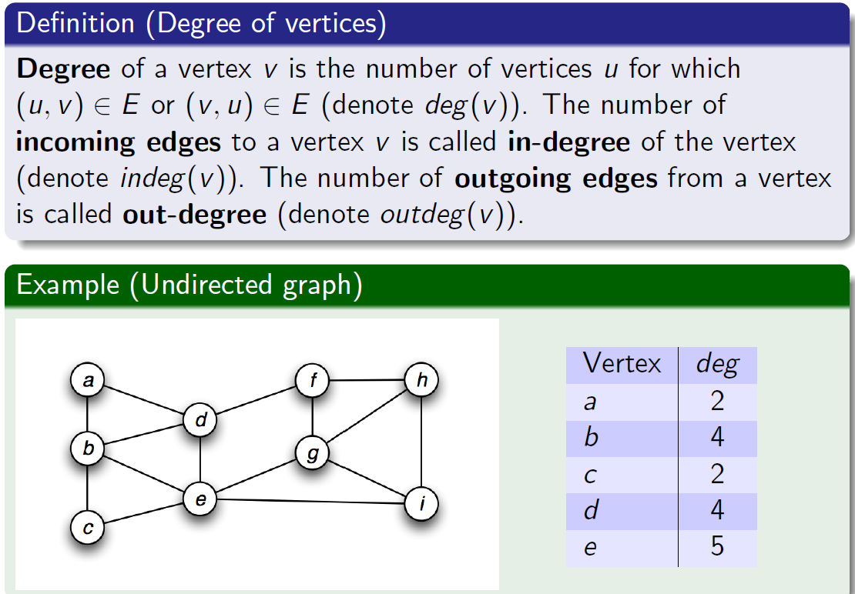
Degree of vertices

Slide 9
Representing Graphs
Assume V = {1, 2, …, n}
An adjacency matrix represents the graph as a n x n matrix A:
A[i, j] = 1 if edge (i, j) ∈ E (or weight of edge) = 0 if edge (i, j) ∉ E

Slide 10
Adjacency Matrix Representation
a b c d e
a
b
0
a
1
1
0
0
e
b
1
0
0
1
1
c
1
0
0
1
0
c
d
d
0
1
1
0
1
e
0
1
0
1
0

Slide 11
Graphs: Adjacency Matrix
Example:
A | 1 | 2 | 3 | 4
1
2
3 |  |  | ??
4
1
a
2
d
4
b
c
3

Slide 12
Graphs: Adjacency Matrix
Example:
A | 1 | 2 | 3 | 4
1 | 0 | 1 | 1 | 0
2 | 0 | 0 | 1 | 0
3 | 0 | 0 | 0 | 0
4 | 0 | 0 | 1 | 0
1
a
2
d
4
b
c
3

Slide 13
Adjacency Matrix Representation
Memory required
O(V²)
Preferred when
The graph is dense: E = O(V²)
Advantage
Can quickly determine if there is an edge between two vertices
Disadvantage
No quick way to determine the vertices adjacent from another vertex.
Listing all the neighbors of ANY vertex takes O(V) time.

Slide 14
Adjacency List Representation
a
b
b
c
a
e
b
a
d
e
c
a
d
c
d
d
b
c
e
e
b
d

Slide 15
Graphs: Adjacency List
Adjacency list: for each vertex v ∈ V, store a list of vertices adjacent to v
Example:
Adj[1] = {2,3}
Adj[2] = {3}
Adj[3] = {}
Adj[4] = {3}
Variation: can also keep a list of edges coming into vertex
1
2
4
3

Slide 16
Adjacency List Representation
Memory required
O(V + E)
Preferred when
for sparse graphs: E = O(V)
Disadvantage
No quick way to determine whether there is an edge between vertices u and v
Advantage
Can quickly determine all the vertices adjacent from a given vertex, v: takes O(N(v)) time, where N(v) is the number of neighbors of v.
O(V) for sparse graphs since E=O(V)
O(V²) for dense graphs since E=O(V²)

Slide 17
Graph Searching
Given: a graph G = (V, E), directed or undirected
Goal: methodically explore every vertex and every edge
Ultimately: build a tree on the graph
Pick a vertex as the root
Choose certain edges to produce a tree
Note: might also build a forest if graph is not connected

Slide 18
Graph Traversals
Ways to traverse/search a graph
Visit every vertex exactly once
Breadth-First Search
Depth-First Search

Slide 19
Breadth-First Search
“Explore” a graph, turning it into a tree
One vertex at a time
Expand frontier of explored vertices across the breadth of the frontier
Builds a tree over the graph
Pick a source vertex to be the root
Find (“discover”) all of its children, then their children, etc.

Slide 20

Basic idea behind breadth first search (BFS)

Slide 21
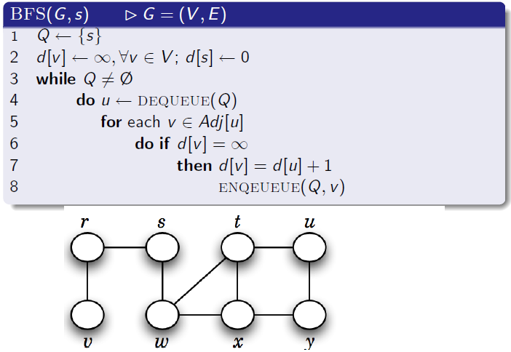
Breadth first search (BFS)

Slide 22
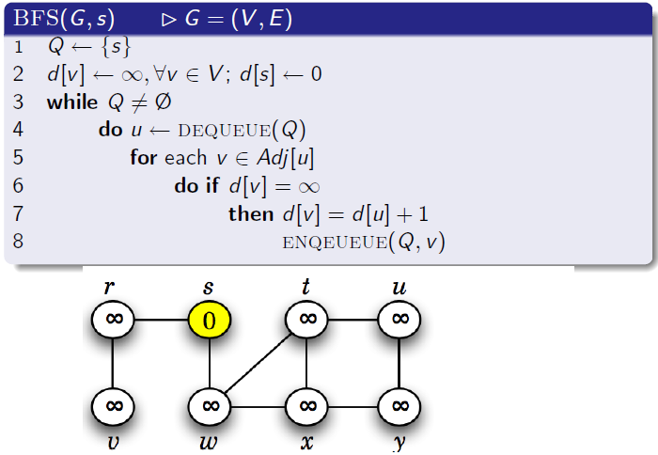
Breadth first search (BFS)

Slide 23
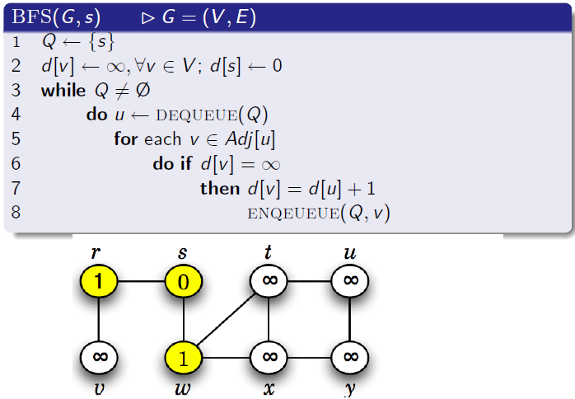
Breadth first search (BFS)

Slide 24
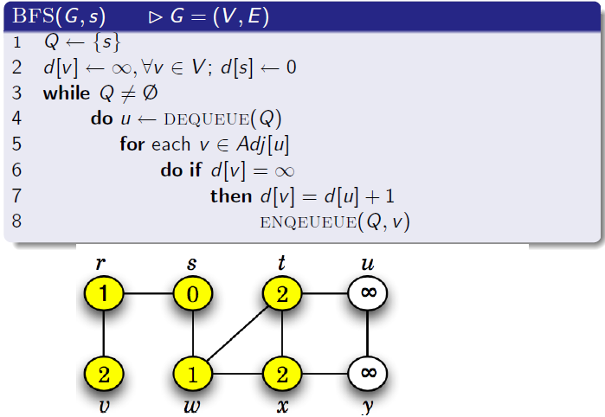
Breadth first search (BFS)

Slide 25
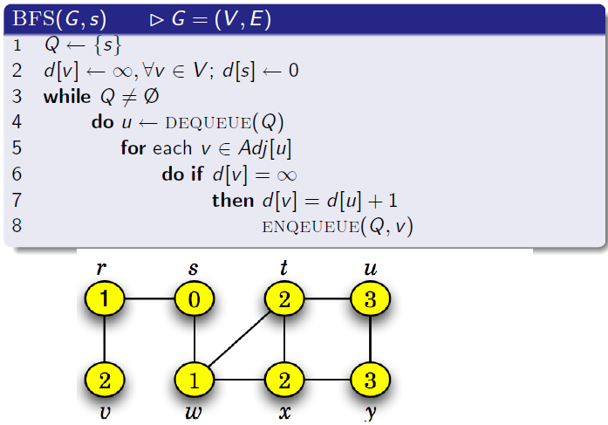
Breadth first search (BFS)

Slide 26
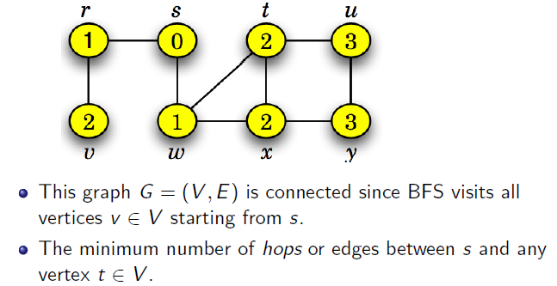
What does this BFS(G, s) algorithm tell us?

Slide 27
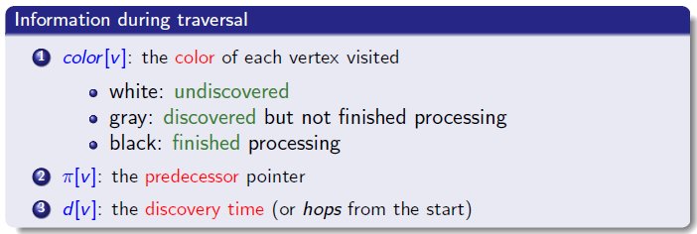
A better Breadth first search (BFS) algorithm

Slide 28
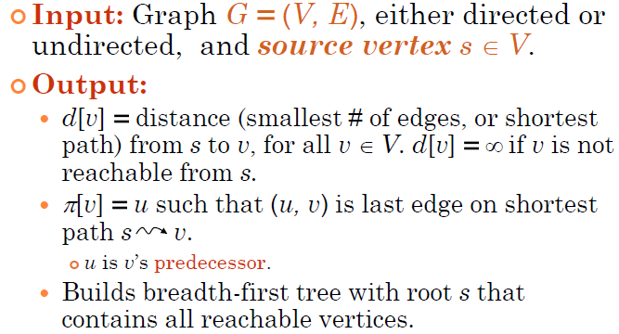
Breadth-First Search

Slide 29
Breadth-First Search
Associate vertex “colors” to guide the algorithm
White vertices have not been discovered
All vertices start out white
Grey vertices are discovered but not fully explored
They may be adjacent to white vertices
Black vertices are discovered and fully explored
They are adjacent only to black and gray vertices
Explore vertices by scanning adjacency list of grey vertices

Slide 30
BFS Trees
BFS tree is not necessarily unique for a given graph
Depends on the order in which neighboring vertices are processed
During the breadth-first search, assign an integer to each vertex
Indicate the distance of each vertex from the source s

Slide 31
BFS(G,s)
1. for each vertex u in V[G] – {s}
2 color[u] ← white
3 d[u] ← ∝
4 π[u] ← nil
5 color[s] ← gray
6 d[s] ← 0
7 π[s] ← nil
8 Q ← Φ
9 enqueue(Q,s)
10 while Q ≠ Φ
11 u ← dequeue(Q)
12 for each v in Adj[u]
13 if color[v] = white
14 color[v] ← gray
15 d[v] ← d[u] + 1
16 π[v] ← u
17 enqueue(Q,v)
18 color[u] ← black
initialization
white: undiscovered
gray: discovered
black: finished
access source s
Q: a queue of discovered vertices
color[v]: color of v
d[v]: distance from s to v
π[u]: predecessor of v

Slide 32

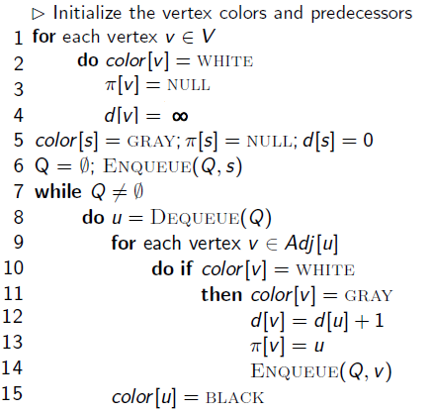
A better Breadth first search (BFS) algorithm

Slide 33
Breadth-First Search: Example
r
s
t
u
∞
∞
∞
∞
∞
∞
∞
∞
v
w
x
y

Slide 34
Breadth-First Search: Example
r
s
t
u
∞
0
∞
∞
∞
∞
∞
∞
v
w
x
y
Q:
s

Slide 35
Breadth-First Search: Example
r
s
t
u
1
0
∞
∞
∞
1
∞
∞
v
w
x
y
Q:
w
r

Slide 36
Breadth-First Search: Example
r
s
t
u
1
0
2
∞
∞
1
2
∞
v
w
x
y
Q:
r
t
x

Slide 37
Breadth-First Search: Example
r
s
t
u
1
0
2
∞
2
1
2
∞
v
w
x
y
Q:
t
x
v

Slide 38
Breadth-First Search: Example
r
s
t
u
1
0
2
3
2
1
2
∞
v
w
x
y
Q:
x
v
u

Slide 39
Breadth-First Search: Example
r
s
t
u
1
0
2
3
2
1
2
3
v
w
x
y
Q:
v
u
y

Slide 40
Breadth-First Search: Example
r
s
t
u
1
0
2
3
2
1
2
3
v
w
x
y
Q:
u
y

Slide 41
Breadth-First Search: Example
r
s
t
u
1
0
2
3
2
1
2
3
v
w
x
y
Q:
y

Slide 42
Breadth-First Search: Example
r
s
t
u
1
0
2
3
2
1
2
3
v
w
x
y
Q:
Ø

Slide 43
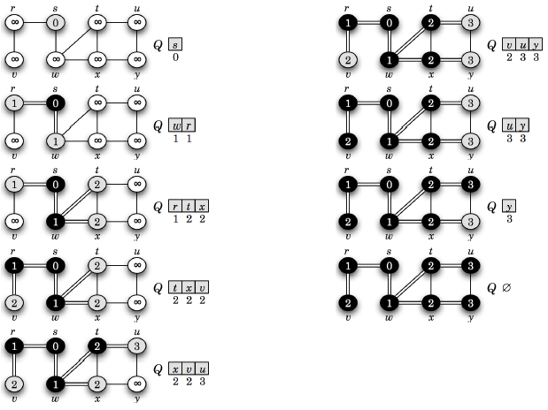

Slide 44
BFS Running Time
Initialization of each vertex takes O(V) time
Every vertex is enqueued once and dequeued once, taking O(V) time
When a vertex is dequeued, all its neighbors are checked to see if they are unvisited, taking time proportional to number of neighbors of the vertex, and summing to O(E) over all iterations
Total time is O(V+E)

Slide 45
Breadth-First Search: Properties
BFS calculates the shortest-path distance to the source node
Shortest-path distance δ(s,v) = minimum number of edges from s to v, or ∞ if v not reachable from s
BFS builds breadth-first tree, in which paths to root represent shortest paths in G
Thus we can use BFS to calculate shortest path from one vertex to another in O(V+E) time

Slide 46
Depth-First Search
Depth-first search is another strategy for exploring a graph
Explore “deeper” in the graph whenever possible
Edges are explored out of the most recently discovered vertex v that still has unexplored edges
When all of v’s edges have been explored, backtrack to the vertex from which v was discovered

Slide 47
Depth-first Search (DFS)
Explore edges out of the most recently discovered vertex v.
When all edges of v have been explored, backtrack to explore other edges leaving the vertex from which v was discovered (its predecessor).
“Search as deep as possible first.”
Continue until all vertices reachable from the original source are discovered.
If any undiscovered vertices remain, then one of them is chosen as a new source and search is repeated from that source.

Slide 48
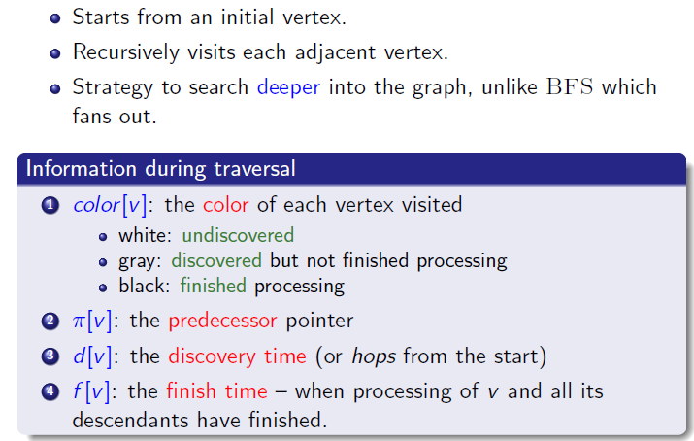
Depth First Search

Slide 49
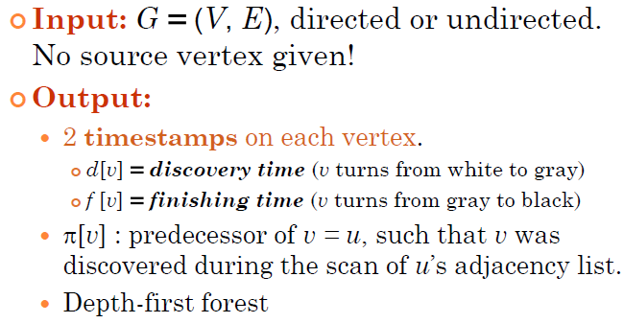
Depth-first Search

Slide 50
Depth-first Search (Pseudocode)
DFS(G)
1. for each vertex u ∈ V[G]
2. do color[u] ← white
3. π[u] ← NIL
4. time ← 0
5. for each vertex u ∈ V[G]
6. do if color[u] = white
7. then DFS-Visit(u)
DFS-Visit(u)
color[u] ← GRAY // White vertex u has been discovered
time ← time + 1
d[u] ← time
for each v ∈ Adj[u]
do if color[v] = WHITE
then π[v] ← u
DFS-Visit(v)
color[u] ← BLACK // Blacken u; it is finished.
f[u] ← time ← time + 1
Uses a global timestamp time.

Slide 51
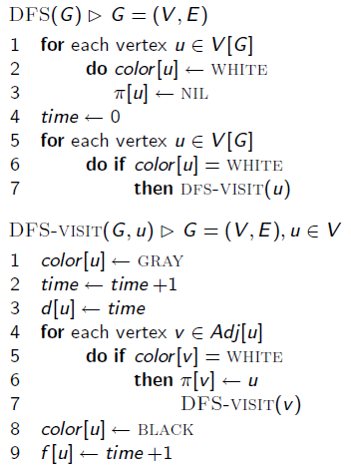
Depth-first Search (Pseudocode)

Slide 52
DFS Example
source vertex
a
d
f
b
g
c
e
h

Slide 53
DFS Example
source vertex
d f
a
d
f
1 |
|
|
b
|
|
g
|
|
|
c
e
h

Slide 54
DFS Example
source vertex
a
d
f
1 |
|
|
b
2 |
|
g
|
|
|
c
e
h

Slide 55
DFS Example
source vertex
a
d
f
1 |
|
|
b
2 |
|
g
3 |
|
|
c
e
h

Slide 56
DFS Example
source vertex
a
d
f
1 |
|
|
b
2 |
|
g
3 | 4
|
|
c
e
h

Slide 57
DFS Example
source vertex
a
d
f
1 |
|
|
b
2 |
|
g
3 | 4
5 |
|
c
e
h

Slide 58
DFS Example
source vertex
a
d
f
1 |
|
|
b
2 |
|
g
3 | 4
5 | 6
|
c
e
h

Slide 59
DFS Example
source vertex
a
d
f
1 |
|
|
b
2 | 7
|
g
3 | 4
5 | 6
|
c
e
h

Slide 60
DFS Example
source vertex
a
d
f
1 |
8 |
|
b
2 | 7
|
g
3 | 4
5 | 6
|
c
e
h

Slide 61
DFS Example
source vertex
a
d
f
1 |
8 |
|
b
2 | 7
9 |
g
3 | 4
5 | 6
|
c
e
h

Slide 62
DFS Example
source vertex
a
d
f
1 |
8 |
|
b
2 | 7
9 |10
g
3 | 4
5 | 6
|
c
e
h

Slide 63
DFS Example
source vertex
a
d
f
1 |
8 |11
|
b
2 | 7
9 |10
g
3 | 4
5 | 6
|
c
e
h

Slide 64
DFS Example
source vertex
a
d
f
1 |12
8 |11
|
b
2 | 7
9 |10
g
3 | 4
5 | 6
|
c
e
h

Slide 65
DFS Example
source vertex
a
d
f
1 |12
8 |11
13|
b
2 | 7
9 |10
g
3 | 4
5 | 6
|
c
e
h

Slide 66
DFS Example
source vertex
a
d
f
1 |12
8 |11
13|
b
2 | 7
9 |10
g
3 | 4
5 | 6
14|
c
e
h

Slide 67
DFS Example
source vertex
a
d
f
1 |12
8 |11
13|
b
2 | 7
9 |10
g
3 | 4
5 | 6
14|15
c
e
h

Slide 68
DFS Example
source vertex
a
d
f
1 |12
8 |11
13|16
b
2 | 7
9 |10
g
3 | 4
5 | 6
14|15
c
e
h

Slide 69
Running Time of DFS
initialization takes O(V) time
second for loop in non-recursive wrapper considers each vertex, so O(V) iterations
one recursive call is made for each vertex
in recursive call for vertex u, all its neighbors are checked; total time in all recursive calls is O(E)
Total time is O(V+E)

